Slide 1
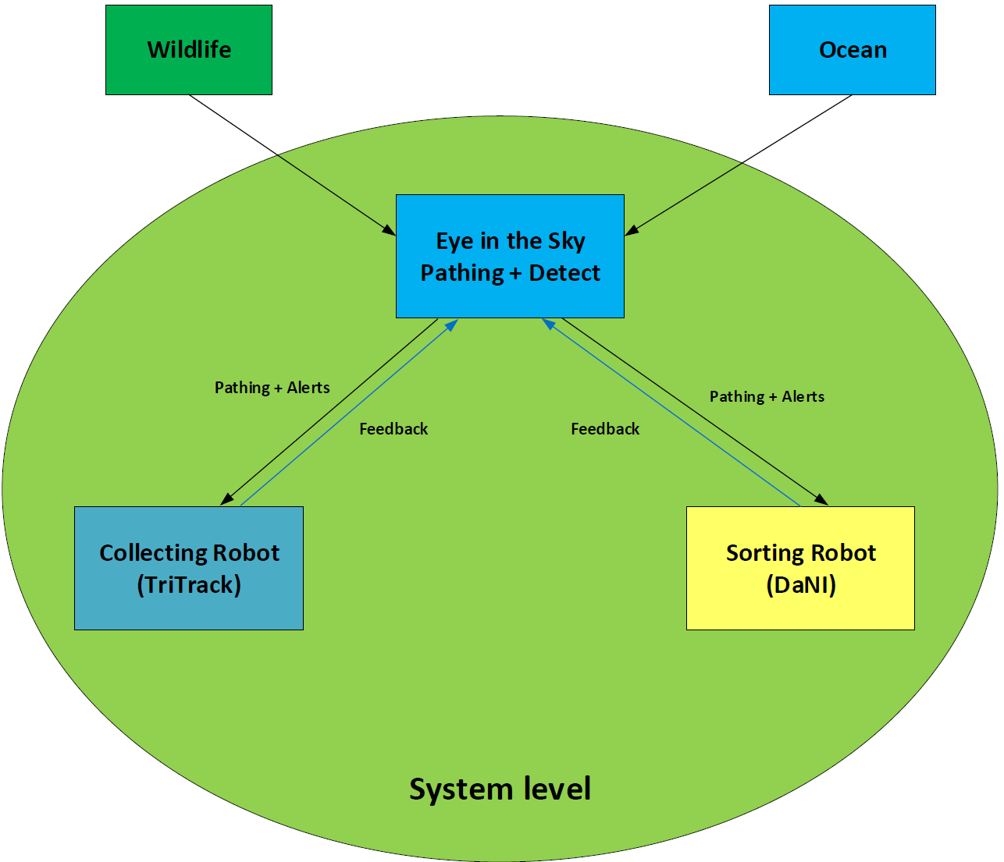

19WSD001 Team Project – E.A.R.T.H
25/10/2019
Objectives/ Aim (What?)
Accurately identify and sort rubbish from a beach
leaving it in a higher standard than when arriving
Identify and mitigate hazards
Activities (How)
Budget statement
Remaining Budget: £199.6
40p on testing components
Budget Plan please see link: https://bit.ly/2BA4OFz
Actions | State
Independent control of robot vehicles and arms Via Xbox Controller
Sorting System
Integration between systems using ROS
Basic Pathing for robots
Detection of Wildlife
Telemetry
Mission phase completion
Stakeholders (Who?)
Group members
University
National Instruments + Prospective Employers
Wildlife on beaches
Phase | Completion
Research + Initial Ideas
Basic Control
Human Control
Automation
Strategy/ Plan (Why?)
Research different ways of sorting rubbish, applying them to devices we have access to
Develop Systems from research presenting ideas and design decisions to group
Implement different modules of the system using ROS
Add complexity to the system over time
Currently working on: Development of potential systems
Target: High level of autonomy
Pathing +Alerts
Pathing +Alerts
Key issues and risks
Need more uControllers e.g. Pi’s, Arduino’s
Hardware failure from lack of best practice
Knowledge Gaps
Computer vision algorithms
ROS
Sorting systems for rubbish
Arm trajectory calculation
Feedback
Team information
E.A.R.T.H
https://github.com/orgs/lboroWMEME-19WSD001/teams/e-a-r-t-h
Programme
Semester 1 End
Easter
Gateway 1 (S1W4)
Gateway 2 (S1W12)
Gateway 3 (S2W7)
VIVA (S2W10)
Key
Completed
In progress
Not Started
Notes:
A version of this is compulsory at each gateway meeting and optional for PST meetings.
In terms of sizing, this should be legible printed on A3, but will probably be viewed on screen. Minimum font size =12
Diagram in the middle should be a top level systems diagram.
The plan will change as the project progresses – that is ok and expected.

